Slide 1

DATA ANALYTICS WITH EXCEL
Narla Sandeep
4968 - Bangalore

Slide 2
Abstract
In this module, we will understand the basics concepts in Excel like modifying the worksheet, exploring the formulas and presenting given information in a graphic format.

Slide 3
Contents
1.Intoduction
2.Sorting Data
3.Charts
4. Pivot Tables
5. VLOOKUP
6. Sparkline
7. SUMIF function

Slide 4
1.Introduction to Microsoft Excel
Microsoft Excel is a spreadsheet program included in the Microsoft suite of applications. Spreadsheets present tables of values arranged in rows and columns that can be manipulated mathematically using both basic and complex arithmetic operations and functions.

Slide 5
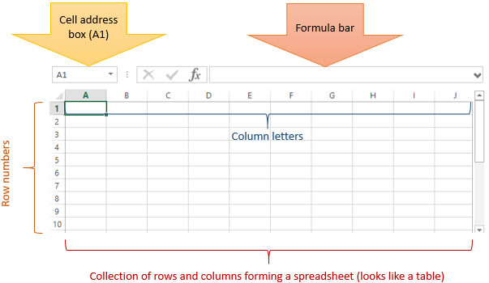

Slide 6
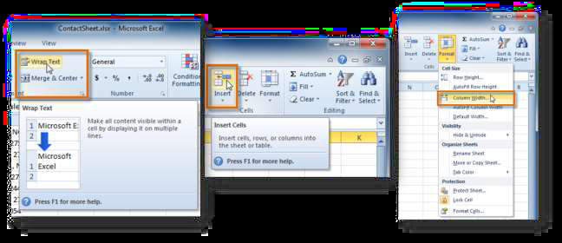
Modifying a Worksheet

Slide 7
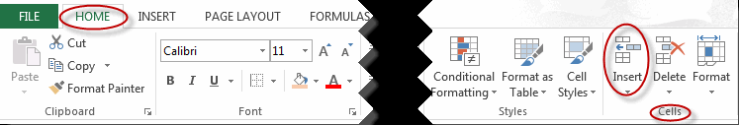
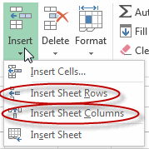

Slide 8
Sort text
Select a cell in the column you want to sort.
On the Data tab, in the Sort & Filter group, do one of the following:
To quick sort in ascending order, click (Sort A to Z).
To quick sort in descending order, click (Sort Z to A).

Slide 9
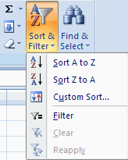
Sorting Data

Slide 10
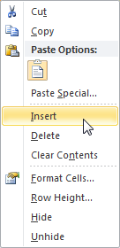
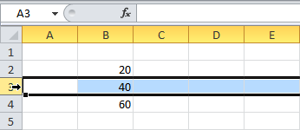
Insert & Delete
Definition:
•Helps to insert & delete a particular Row/Column in excel
Inserting/Deleting a Row/Column:
•Right click , then click insert/Delete
•Same procedure to be applied for Column/Row

Slide 11
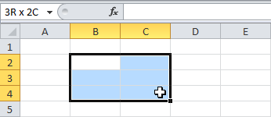
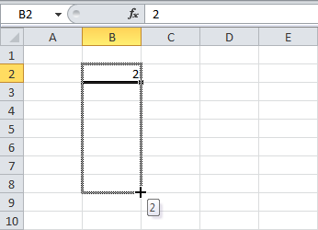
Range
Definition:
•A range is a collection of two or more cells
Selecting a range:
•To select the range B2:C4, click on cell B2 and drag it to cell C4
•To select a range of individual cells, hold down CTRL and click on each cell that you want to include in the range
To fill a Range:
•Enter a value 2 into cell B2
•Selectcell B2, click on the lower right corner of cell B2 and dragitdownto cell B8.

Slide 12
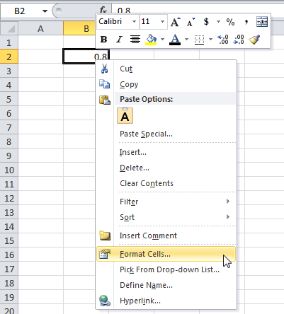
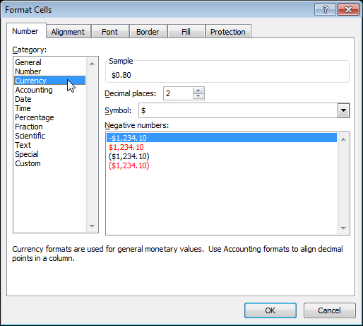
Format Cells
Definition:
•Efficiently highlighting your data to make it impactful
Understanding Formatting cells:
•By default, Excel uses the General format (no specific number format) for numbers. To apply a number format, use the 'Format Cells' dialog box

Slide 13
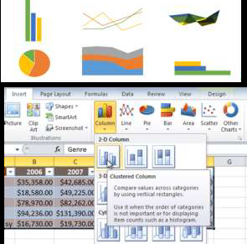
Charts in MS Excel

Slide 14
CREATING CHARTS
In Microsoft Excel, you can show numbers in a chart. On the Insert tab, you can choose from a variety of chart types,including column, line, pie, bar, area, and scatter. The basic procedure for creating a chart is the same no matter what type of chart you choose. As you change your data, your chart will automatically update

Slide 15
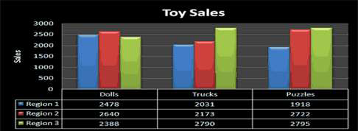

Slide 16
Pivot Tables
Pivot tables are one of Excel's most powerful features. A pivot table allows you to extract the significance from a large, detailed data set.
Our data set consists of 213 records and 6 fields. Order ID, Product, Category, Amount, Date and Country.

Slide 17
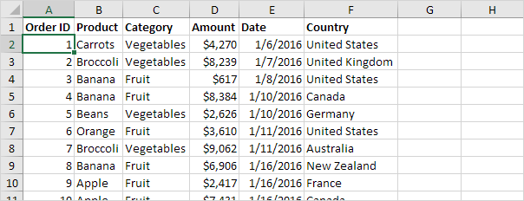

Slide 18
Insert a Pivot Table
To insert a pivot table, execute the following steps.
1. Click any single cell inside the data set.
2. On the Insert tab, in the Tables group, click PivotTable.
The following dialog box appears. Excel automatically selects the data for you. The default location for a new pivottable is New Worksheet

Slide 19

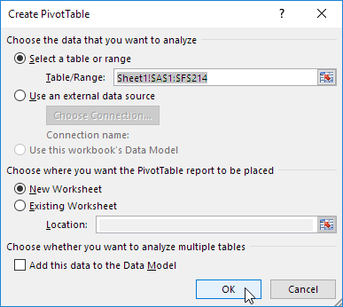

Slide 20
VLOOKUP
LOOKUP: Use LOOKUP when you need to look in a single row or column and find a value from the same position in a second row or column.
•For example, let's say you know the part number for an auto part, but you don't know the price. You can use the LOOKUP function to return the price in cell H2 when you enter the auto part number in cell H1.

Slide 21
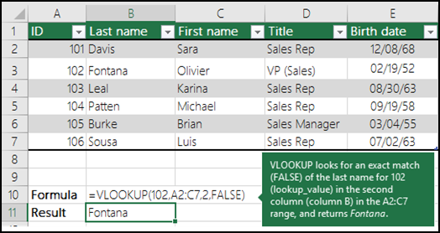
VLOOKUP: Use VLOOKUP when you need to find things in a table or a range by row. For example, look up a price of an automotive part by the part number.

Slide 22
Sparkline in Excel
Sparklines in Excel are graphs that fit in one cell and give you information about the data.
Insert Sparklines
To insert sparklines, execute the following steps.
1. Select the cells where you want the sparklines to appear. In this example, we select the range G2:G4.

Slide 23
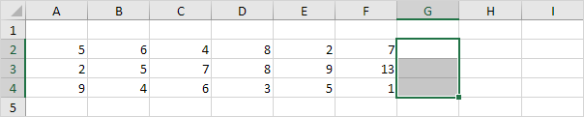

2. On the Insert tab, in the Sparklines group, click Line.

Slide 24
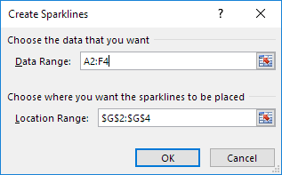
3. Click in the Data Range box and select the range A2:F4.

Slide 25
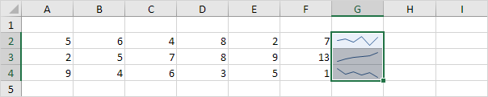
4. Click OK
.
Result:

Slide 26
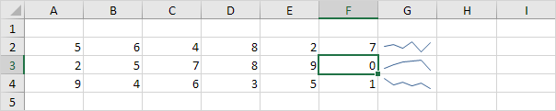
5. Change the value of cell F3 to 0.
Result. Excel automatically updates the sparkline.

Slide 27
SUMIF function in Excel
The SUMIF function is a worksheet function that adds all numbers in a range of cells based on one criteria (for example, is equal to 2000).
The SUMIF function is a built-in function in Excel that is categorized as a Math/Trig Function. It can be used as a worksheet function (WS) in Excel. As a worksheet function, the SUMIF function can be entered as part of a formula in a cell of a worksheet.
The SUMIF function returns a numeric value.
Syntax:
SUMIF( range, criteria, [sum_range]

Slide 28
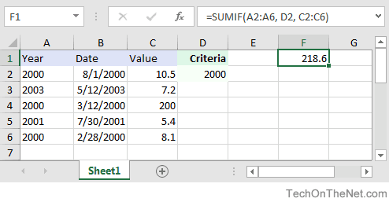
For Example
=SUMIF(A2:A6, D2, C2:C6)
Result: 218.6 'Criteria is the value in cell D2

Slide 29
Thank you

Slide 30
Any Queries?!
`

